Slide 1





a
T_{θ} = 0.1s
“Theta
sweep”
b
θ-modulation of firing rate
c
STDP learning rule
d
Synaptic weight matrix, W_{ij}
e
Successor matrix, M_{ij}
2π
1
ΔW_{ij}
1
π
Postsynaptic cell i
Cell i
θ-phase
τ⁻ = 40 ms
t_{i} - t_{j}
τ⁺ = 20 ms
0
0
-0.4
0
½
1
Fraction of distance through field
Presynaptic cell j
Cell j

Slide 2
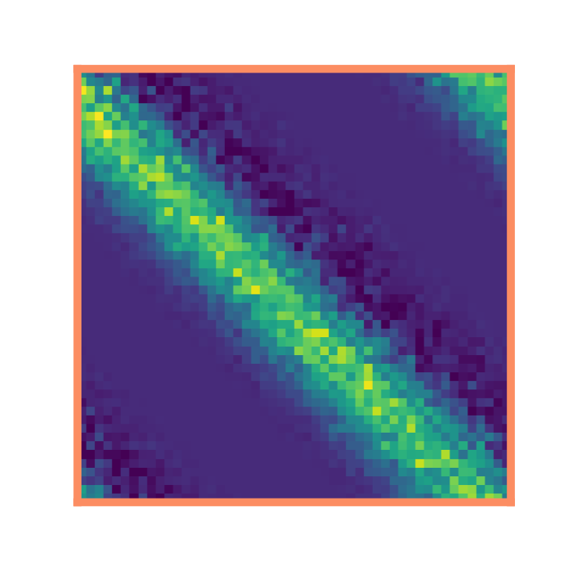
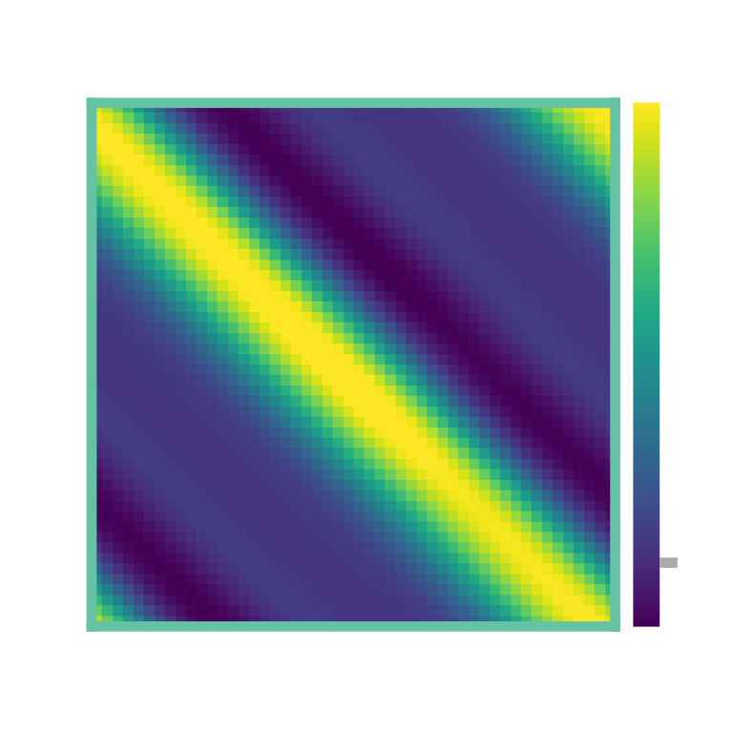
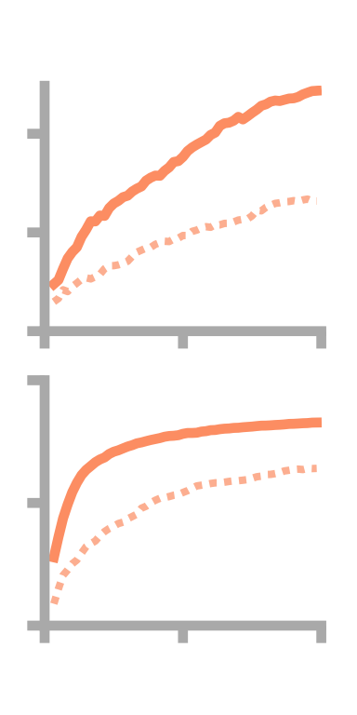
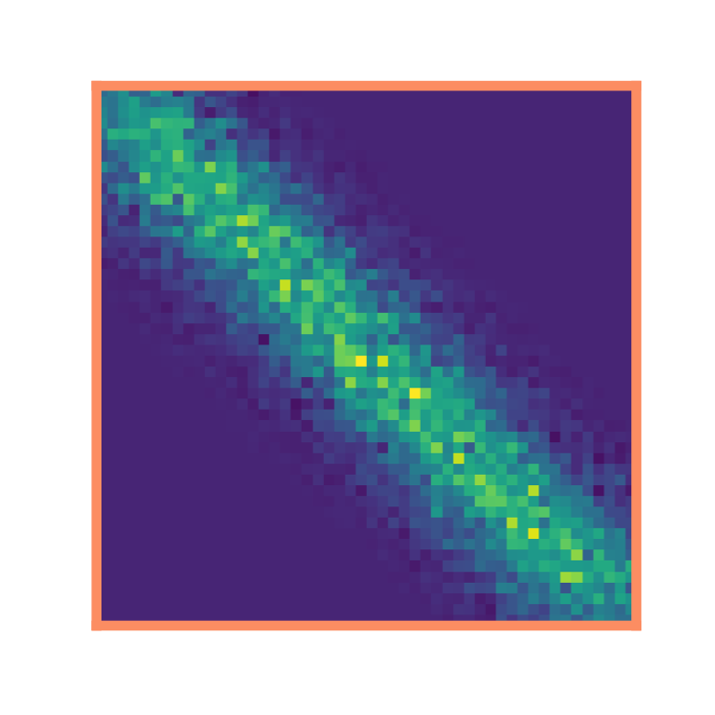
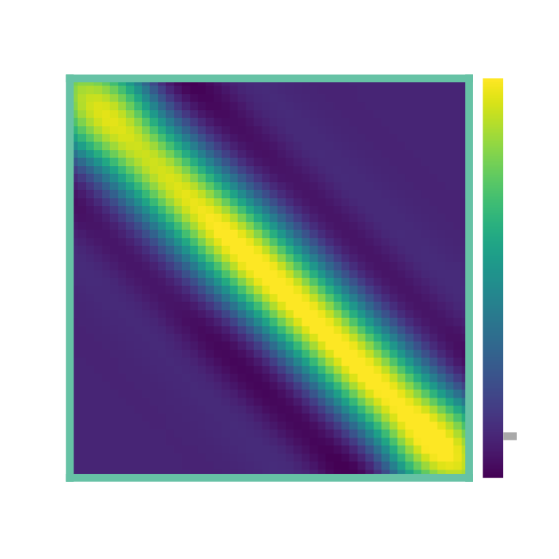
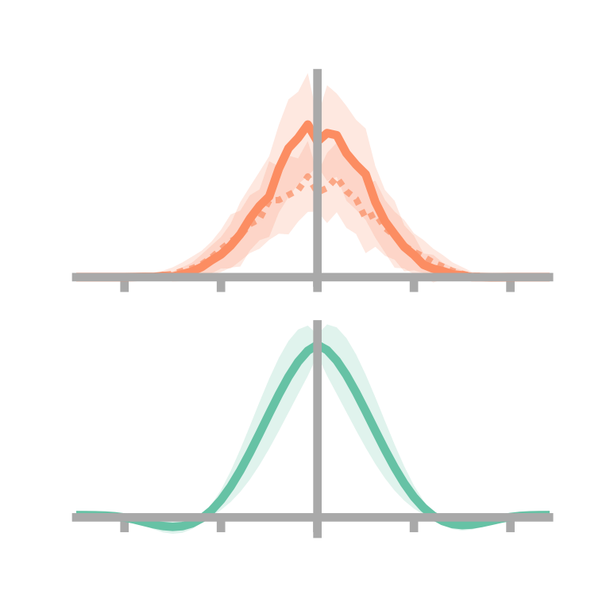
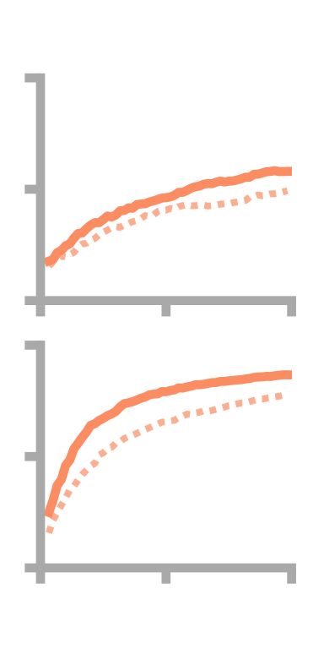
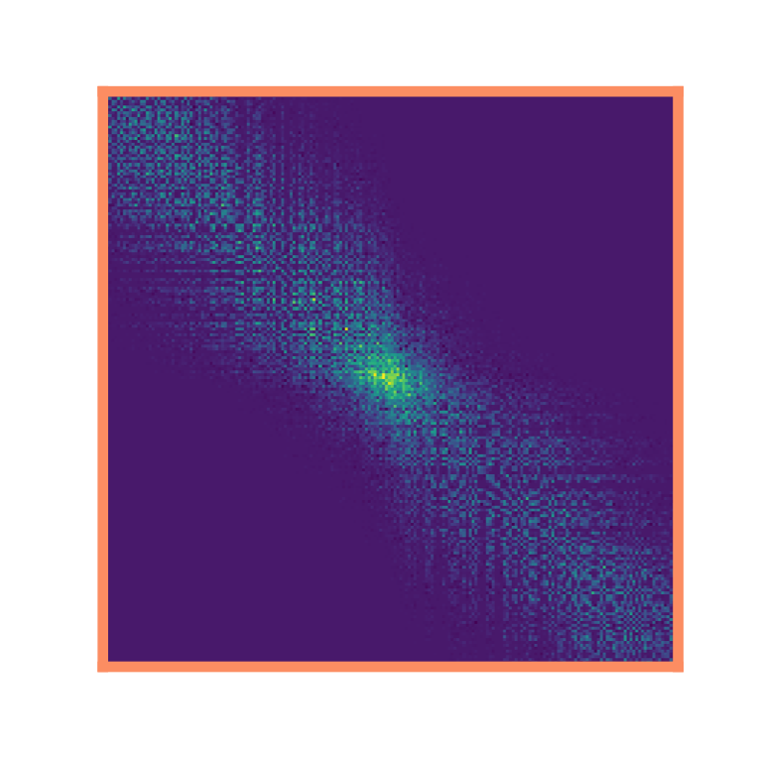
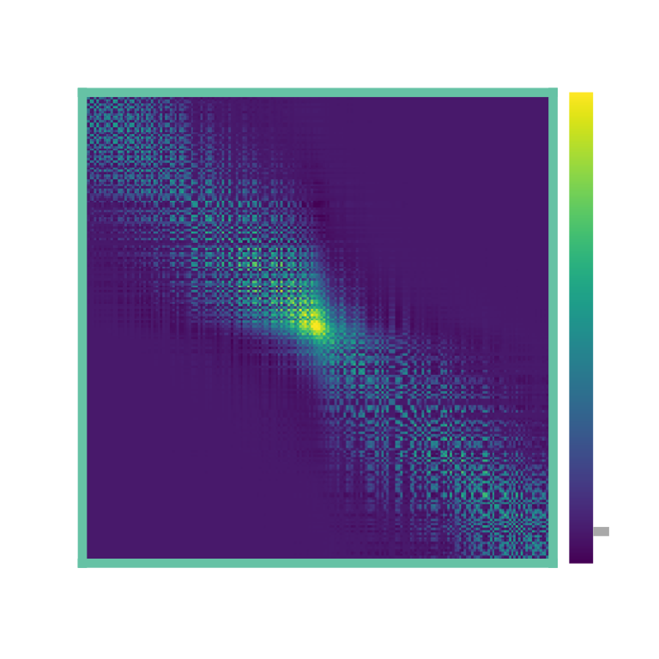
a
σ = 1 m
1D loop maze
b
Synaptic weights, W_{ij}
c
Successor matrix, M_{ij}
d
⟨W⟩
Skewness
e
-0.15
4
⟨W_{no-θ}⟩
0.00
SNR
2
i
0
⟨M⟩
-0.35
1
R²
0
½
j
-2
-1
1
2
0
x_{i} – x_{j} / m
0
15
30
Learning time / min
f
1D corridor maze
g
h
i
j
4
2
SNR
i
0
1
R²
0
½
j
-2
-1
1
2
0
x_{i} – x_{j} / m
0
15
30
k
l
m
Learning time / min
2D two room maze
0

Slide 3

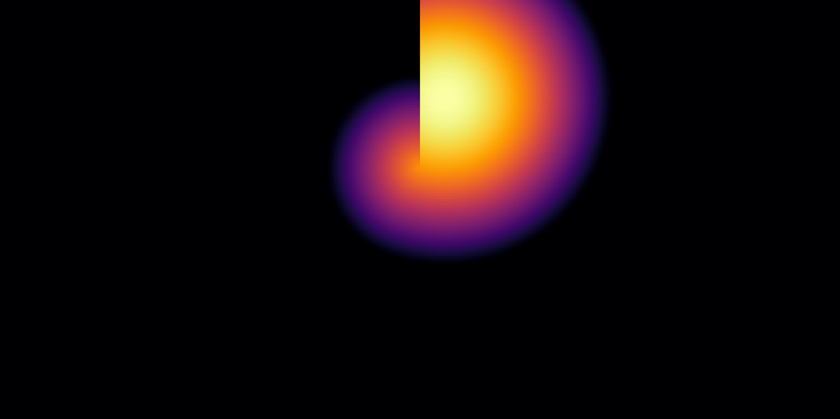

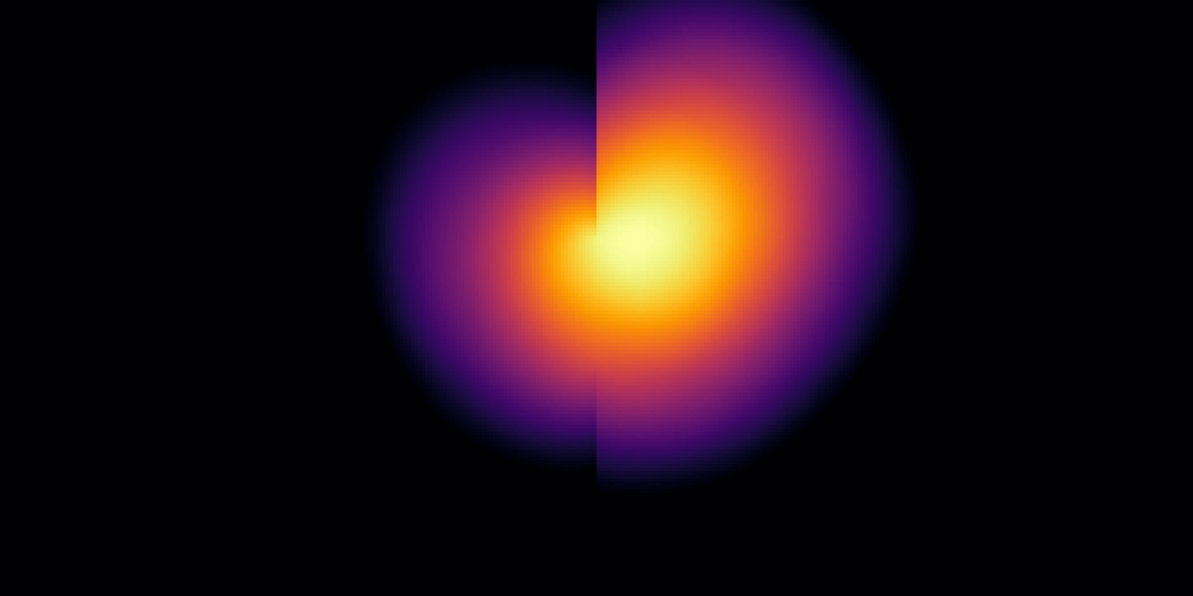
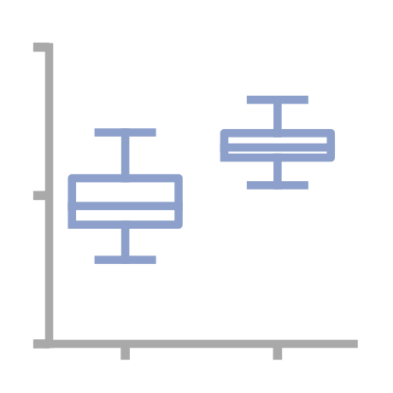
a
σ = 1 m
1D loop maze
skew = 0.00±0.00
Basis Feature
-0.20±0.06
Place Cell
b
1D corridor maze
0.00±0.00
BF
-0.01±0.06
PC
c
2D two room maze
d
2D two room maze
BF
e = 0.00
BF
PC
***
0.8
Eccentricity
0.4
e = 0.54
0
Cells
near
centre
Cells
near
wall
PC

Slide 4
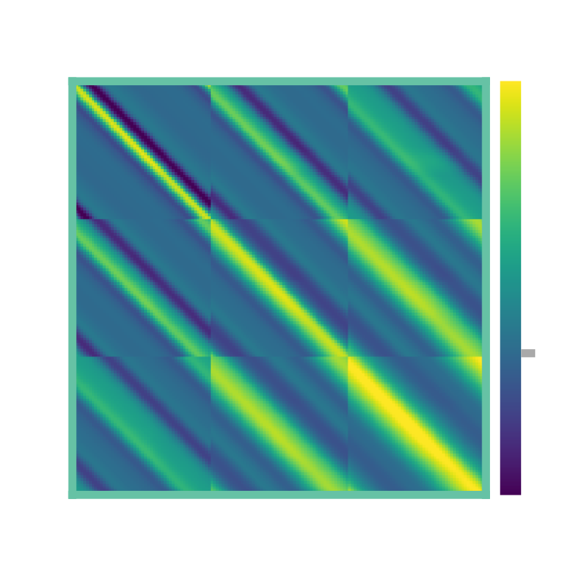
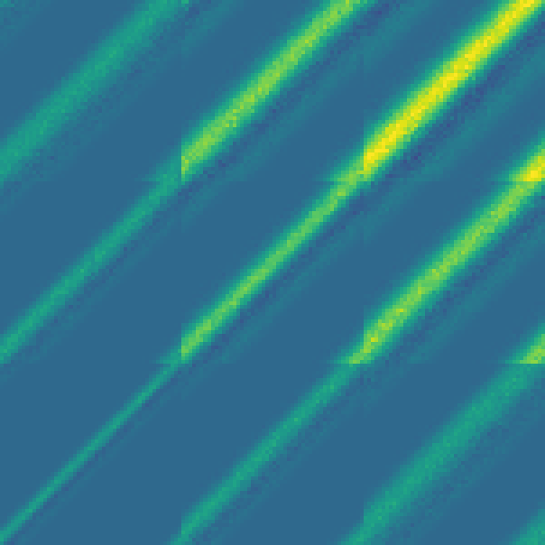
a
σ = 0.5 m
σ = 1 m
σ = 1.5 m
b
c
10
Dorsal
8
STDP matrix, W_{ij}
time horizon / s
HPC
6
4
Ventral
2
0
0
0.5
1
1.5
2
d
Synaptic weight matrix, W_{ij}
e
Basis cell size, σ / m
Successor matrix, M_{ij}
σ = 0.5 m
σ = 1 m
0
σ = 1.5 m

Slide 6
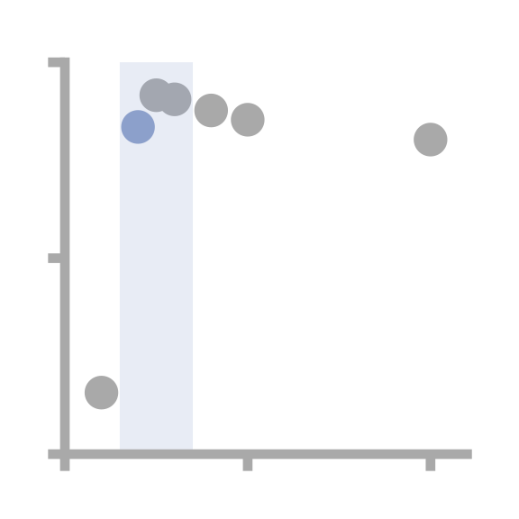
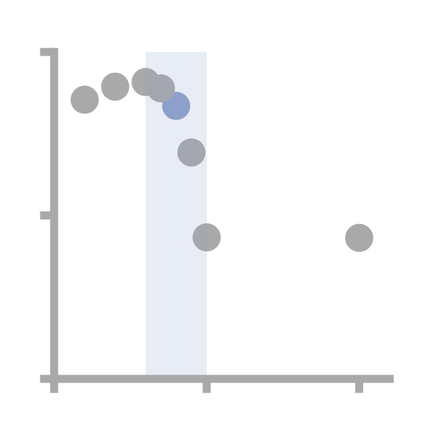
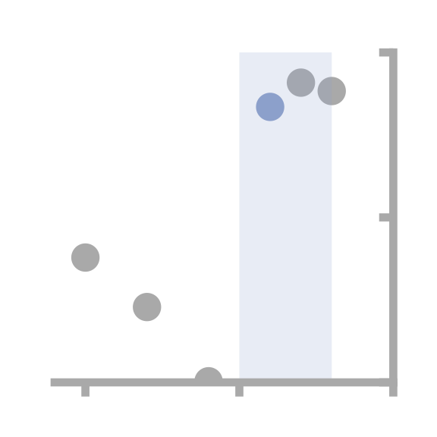
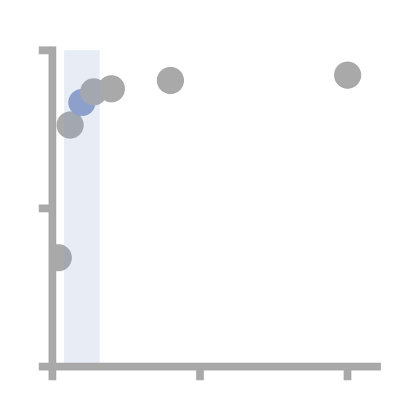
 |  |  | Sweep range | Sweep optima* parameters | Biological parameters†
Simulation | STPD | τ_{STDP}⁺ / ms | [10→100] | 100 | 20‡
parameters |  | τ_{STDP}⁻ / ms | [10→100] | 100 | 40‡
 |  | a_{STDP} | [-0.1→-1.0] | -0.8 | -0.4‡
 |  | firing rate / Hz | [1→50] | 20 | 5§
 | θ | precess fraction, f | no sweep | 0.5‖
 |  | κ | no sweep | 1‖
 |  | θ-frequency, ν_{θ} / Hz | no sweep | 10¶
 |  | Learning rate, η_{STDP} | no sweep | 0.05
 | TD | τ_{TD} / s | no sweep | 4
 |  | Learning rate, η_{TD} | no sweep | 0.01
 |  | L2 regularisation, λ | no sweep | 0.01
Performance |  | R² (M,W) | - | 0.96 (0.87) | 0.83 (0.60)
metrics |  | SNR(W) | - | 34.1 (29.2) | 7.7 (4.0)
θ (No-θ) |  | skew ⟨W⟩ vs. skew ⟨M⟩ = -0.36 | - | 0.00 (0.00) | -0.10 (0.00)
 |  | x_{max} ⟨W⟩ vs. argmax ⟨M⟩ = -0.15 | - | -0.25 (-0.05) | -0.15
*as determined by R² (M,W_{θ})
† as used in paper, determined from literature…
‡ Bush et al. (2010)
§ Muller ….
‖ Fitted to Jeewajee and Barry (2014), figure 5a
¶ Find source
1
R²
0.5
0
0
50
100
0
50
100
-1
-0.5
0
0
50
100
τ⁺_{STDP} / ms
τ⁻_{STDP} / ms
a_{STDP}
Firing rate / Hz

